Slide 1
Structured Web Documents in XML (b)
Adapted from slides from Grigoris Antoniou and Frank van Harmelen

Slide 2
Outline
(1) Introduction
(2) XML details
(3) Structuring
DTDs
XML Schema
(4) Namespaces
(5) Accessing, querying XML documents: XPath
(6) Transformations: XSLT
(7) Summary

Slide 3
What’s a Namespace?
Wikipedia: “In computing, a namespace is a set of symbols that are used to organize objects of various kinds, so that these objects may be referred to by name”
Useful when we need to combine or integrate multiple vocabularies
Providing a way to avoid name collisions

Slide 4
Namespaces
XML namespaces provide uniquely named elements & attributes in an XML document
XML document may use >1 DTD or schemas
Since each was developed independently, name collisions can occur
Solution: use different prefix prefix:name
Where a prefix is associated with a URI, which can be a DTD or schema file
Namespaces even more important in RDF

Slide 5
URLs, URNs, URIs, …

Slide 6
An Example
<vu:instructors
xmlns:vu="http://www.vu.com/empDTD"
xmlns:gu="http://www.gu.au/empDTD"
xmlns:uky=http://www.uky.edu/empDTD
<uky:faculty uky:title="assistant professor"
uky:name="John Smith"
uky:department="Computer Science"/>
<gu:academicStaff gu:title="lecturer"
gu:name="Mate Jones"
gu:school="Information Technology"/>
</vu:instructors>

Slide 7
Namespace Declarations
Namespaces declared within elements for use in it and its children (elements and attributes)
Namespace declaration has form:
xmlns:prefix="location"
location is a URI, often the DTD or schema file
If no prefix specified: xmlns="location" then the location is used as the default prefix
We’ll see this same idea used in RDF

Slide 8
Outline
(1) Introduction
(2) Description of XML
(3) Structuring
DTDs
XML Schema
(4) Namespaces
(5) Accessing, querying XML docs: XPath
(6) Transformations: XSLT

Slide 9
Addressing & Querying XML Documents
In relational databases, parts of a database can be selected and retrieved using SQL
Also very useful for XML documents
Query languages: XQuery, XQL, XML-QL
The central concept of XML query languages is a path expression
Specifies how a node or set of nodes, in the tree representation, can be reached
Useful for extracting data from XML

Slide 10
XPath
XPath is core for XML query languages
Gives a way to select nodes in XML documents
Operates on the tree data model of XML
Has a non-XML syntax
Versions
XPath 1.0 (1999) is widely supported
XPath 2.0 (2007) more expressive subset of Xquery
XPath 3.1 (2017) current version, more features

Slide 11
Types of Path Expressions
Absolute (starting at the root of the tree)
Syntactically they begin with the symbol /
It refers to the root of the document (one level above document’s root element)
Relative to a context node

Slide 12
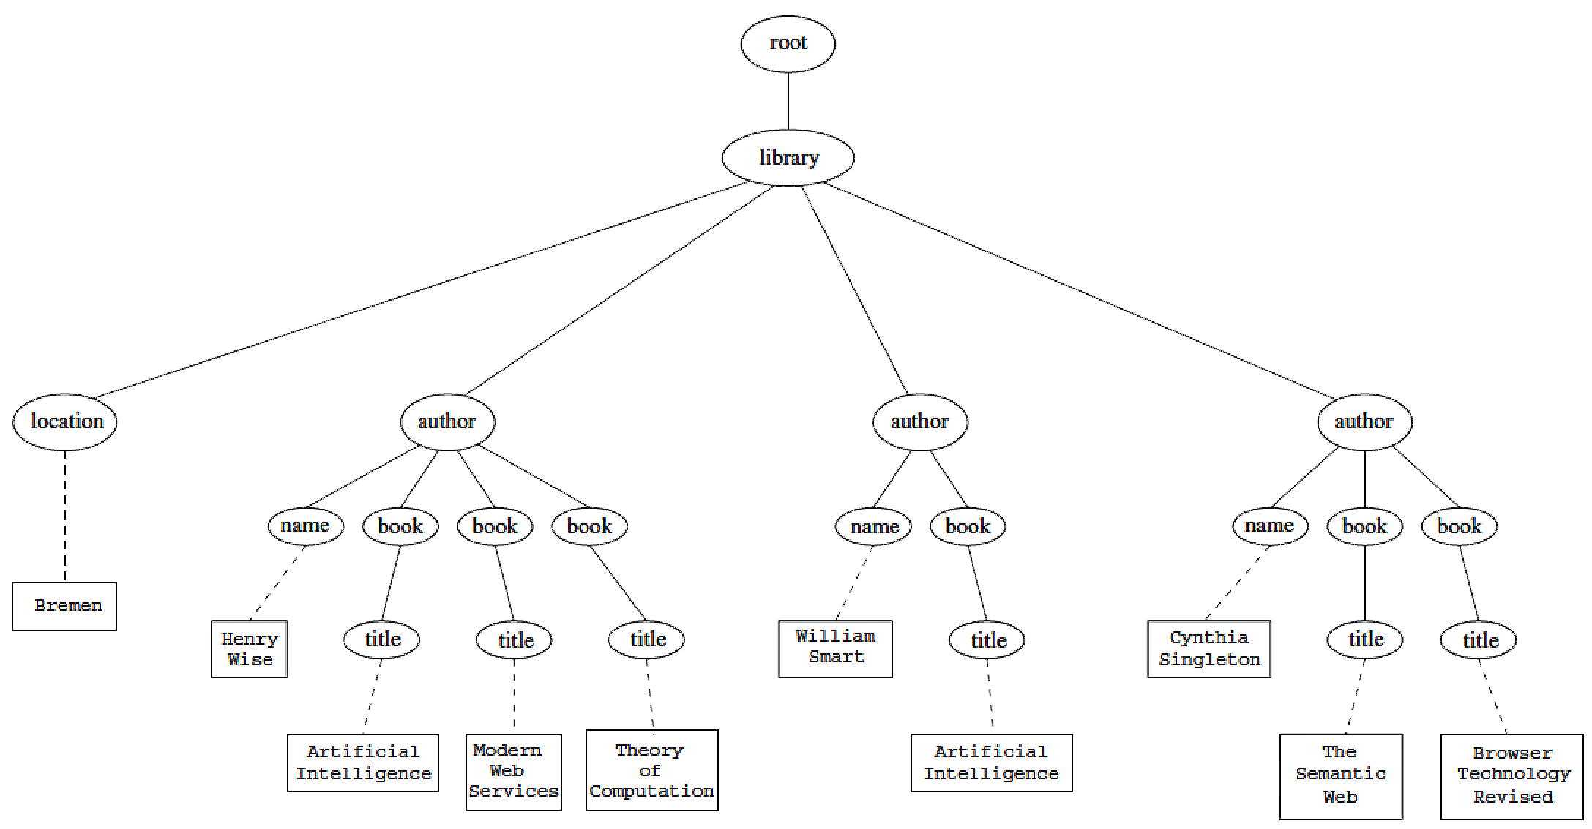
An XML Example
<library location="Bremen">
<author name="Henry Wise">
<book title="Artificial Intelligence"/>
<book title="Modern Web Services"/>
<book title="Theory of Computation"/>
</author>
<author name="William Smart">
<book title="Artificial Intelligence"/>
</author>
<author name="Cynthia Singleton">
<book title="The Semantic Web"/>
<book title="Browser Technology Revised"/>
</author>
</library>

Slide 13
Tree Representation
<library location="Bremen">
<author name="Henry Wise">
<book title="Artificial Intelligence"/>
<book title="Modern Web Services"/>
<book title="Theory of Computation"/>
</author>
<author name="William Smart">
<book title="Artificial Intelligence"/>
</author>
<author name="Cynthia Singleton">
<book title="The Semantic Web"/>
<book title="Browser Technology Revised"/>
</author>
</library>

Slide 14
Examples of Path Expressions in XPath
Q1: /library/author
Addresses all author elements that are children of the library element node immediately below root
/t1/.../tn, where each ti+1 is a child node of ti, is a path through the tree representation
Q2: //author
Consider all elements in document and check whether they are of type author
Path expression addresses all author elements anywhere in the document

Slide 15
Examples of Path Expressions in XPath
Q3: /library/@location
Addresses location attribute nodes within library element nodes
The symbol @ is used to denote attribute nodes
Q4: //book/@title="Artificial Intelligence”
Addresses all title attribute nodes within book elements anywhere in the document that have the value “Artificial Intelligence”

Slide 16
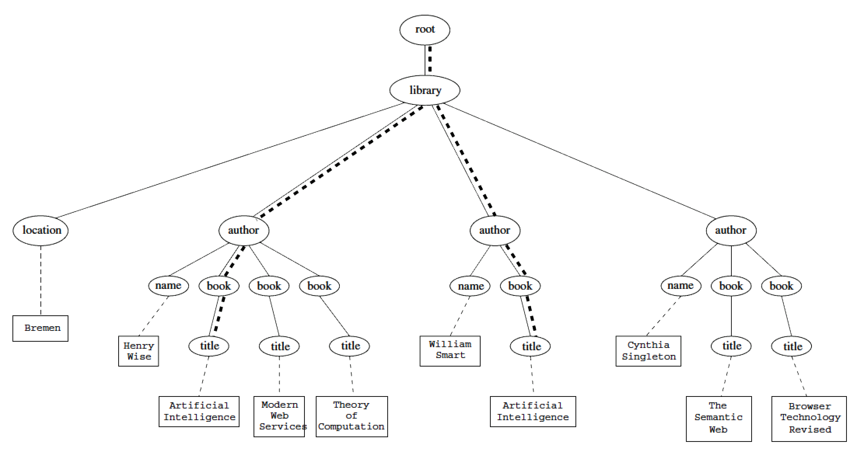
Tree Representation of Query 4
//book/@title="Artificial Intelligence”

Slide 17
Examples of Path Expressions in XPath
Q5: /book[@title="Artificial Intelligence"]
Addresses all books with title “Artificial Intelligence”
A test in brackets is a filter expression that restricts the set of addressed nodes.
Note differences between Q4 and Q5:
Query 5 addresses book elements, the title of which satisfies a certain condition.
Query 4 collects title attribute nodes of book elements

Slide 18
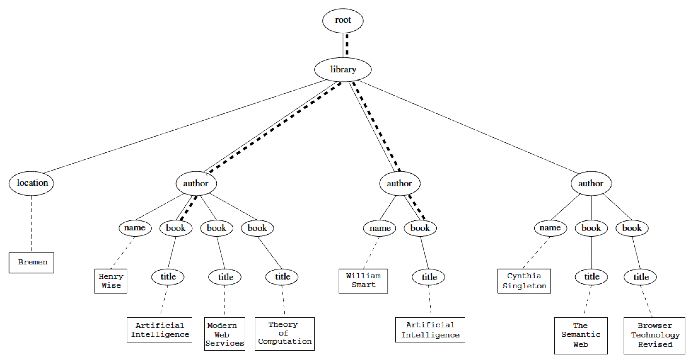
Tree Representation of Query 5
/book[@title="Artificial Intelligence"]

Slide 19
Examples of Path Expressions in XPath
Q6: Address first author element node in the XML document
//author[1]
Q7: Address last book element within the first author element node in the document
//author[1]/book[last()]
Q8: Address all book element nodes without a title attribute
//book[not @title]

Slide 20
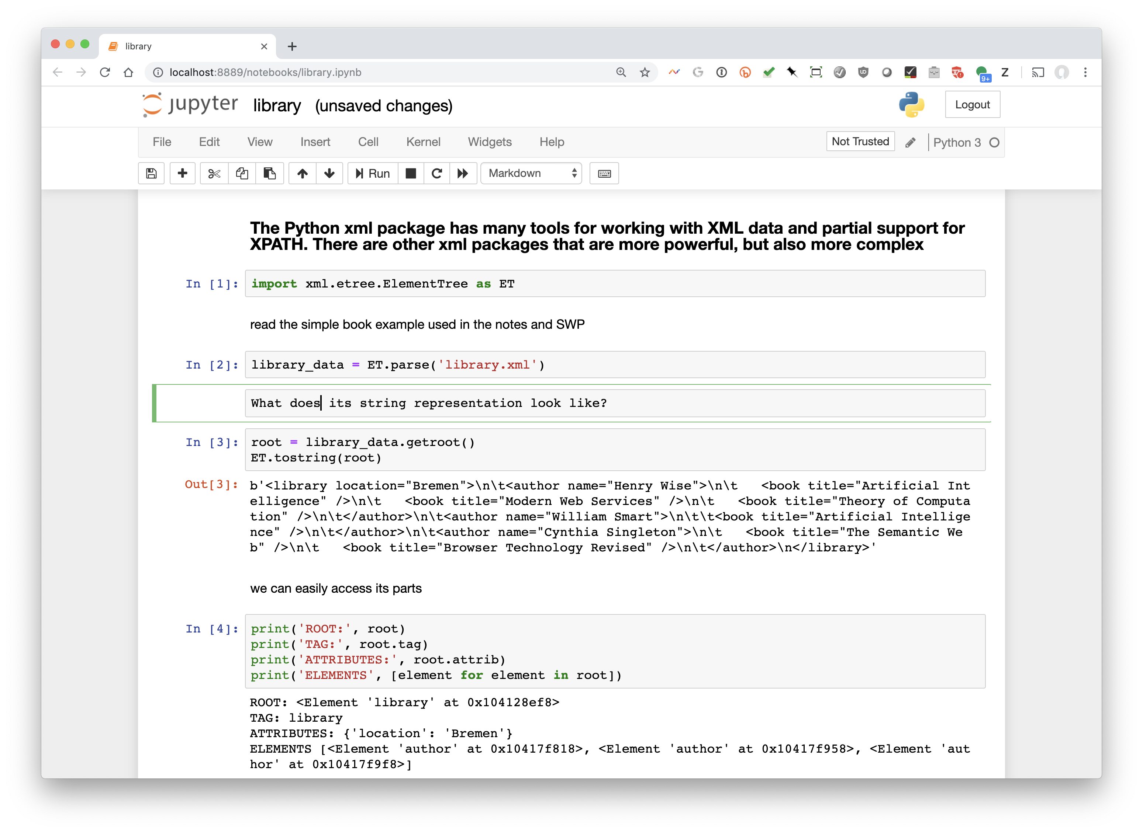
Working with XML in Python

Slide 21
General Form of Path Expressions
A path expression consists of a series of steps, separated by slashes
A step consists of
An axis specifier,
A node test, and
An optional predicate
(5) XPath

Slide 22
General Form of Path Expressions
An axis specifier determines the tree relationship between the nodes to be addressed and the context node
E.g. parent, ancestor, child (the default), sibling, attribute node
// is such an axis specifier: descendant or self
(5) XPath

Slide 23
General Form of Path Expressions
A node test specifies which nodes to address
The most common node tests are element names
E.g., * addresses all element nodes
comment() addresses all comment nodes
(5) XPath

Slide 24
General Form of Path Expressions
Predicates (or filter expressions) are optional and are used to refine the set of addressed nodes
E.g., the expression [1] selects the first node
[position()=last()] selects the last node
[position() mod 2 =0] selects the even nodes
XPath has a more complicated full syntax.
We have only presented the abbreviated syntax
(5) XPath

Slide 25
Outline
(1) Introduction
(2) Description of XML
(3) Structuring
DTDs
XML Schema
(4) Namespaces
(5) Accessing, querying XML documents: XPath
(6) Transformations: XSLT

Slide 26
Displaying XML Documents
<author>
<name>Grigoris Antoniou</name>
<affiliation>University of Bremen</affiliation>
<email>ga@tzi.de</email>
</author>
may be displayed in different ways:
Grigoris Antoniou Grigoris Antoniou
University of Bremen University of Bremen
ga@tzi.de ga@tzi.de
Idea: use an external style sheet to transform an XML tree into an HTML or XML tree

Slide 27
Style Sheets
Style sheets can be written in various languages
E.g. CSS2 (cascading style sheets level 2)
XSL (extensible stylesheet language)
XSL includes
a transformation language (XSLT)
XSLT 3.0 is the current spec as of 2017
a formatting language
Both are XML applications

Slide 28
XSL Transformations (XSLT)
XSLT specifies rules to transform XML document to
another XML document
HTML document
plain text
Output may use same DTD or schema, or completely different vocabulary
XSLT can be used independently of formatting language

Slide 29
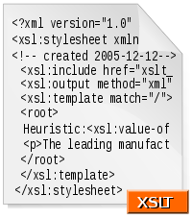
XSLT Use Cases
Move data & metadata from one XML representation to another
Share information between appli- cations using different schemas
Processing XML content for ingest into a program or database
The following example show XSLT used to display XML documents as HTML

Slide 30
XSLT Transformation into HTML
<author>
<name>Grigoris Antoniou</name>
<affiliation>University of Bremen </affiliation>
<email>ga@tzi.de</email>
</author>
<xsl:template match="/author">
<html>
<head><title>An author</title></head>
<body bgcolor="white">
<b><xsl:value-of select="name"/></b><br/>
<xsl:value-of select="affiliation"/><br/>
<i><xsl:value-of select="email"/></i>
</body>
</html>
</xsl:template>

Slide 31
Style Sheet Output
<author>
<name>Grigoris Antoniou</name>
<affiliation>University of Bremen</affiliation>
<email>ga@tzi.de</email>
</author>
<xsl:template match="/author"> <html>
<head><title>An author</title></head>
<body bgcolor="white">
<b><xsl:value-of select="name"/></b><br/>
<xsl:value-of select="affiliation"/><br/>
<i><xsl:value-of select="email"/></i>
</body>
</html></xsl:template>
<html>
<head><title>An author</title></head>
<body bgcolor="white">
<b>Grigoris Antoniou</b><br/>
University of Bremen<br/>
<i>ga@tzi.de</i>
</body>
</html>

Slide 32
Observations About XSLT
XSLT documents are XML documents
XSLT sits on top of XML
The XSLT document defines a template
In this case, an HTML document with placeholders for content to be inserted
xsl:value-of retrieves value of an element and copies it into output document
It places some content into the template

Slide 33
A Template
<html>
<head><title>An author</title></head>
<body bgcolor="white">
<b>...</b><br>
...<br>
<i>...</i>
</body>
</html>
(5) XSLT transformations

Slide 34
Auxiliary Templates
We may have XML documents with details of several authors
It is a waste of effort to treat each author element separately
In such cases, a special template is defined for author elements, which is used by the main template

Slide 35
Example of an Auxiliary Template
<authors>
<author>
<name>Grigoris Antoniou</name>
<affiliation>University of Bremen</affiliation>
<email>ga@tzi.de</email>
</author>
<author>
<name>David Billington</name>
<affiliation>Griffith University</affiliation>
<email>david@gu.edu.net</email>
</author>
</authors>

Slide 36
Example of an Auxiliary Template
<xsl:template match="/">
<html>
<head><title>Authors</title></head>
<body bgcolor="white">
<xsl:apply-templates select="author"/>
<!-- apply templates for AUTHORS children -->
</body>
</html>
</xsl:template>

Slide 37
Example of an Auxiliary Template
<xsl:template match="authors">
<xsl:apply-templates select="author"/>
</xsl:template>
<xsl:template match="author">
<h2><xsl:value-of select="name"/></h2>
<p> Affiliation:<xsl:value-of select="affiliation"/><br/>
Email: <xsl:value-of select="email"/> </p>
</xsl:template>

Slide 38
Multiple Authors Output
<html>
<head><title>Authors</title></head>
<body bgcolor="white">
<h2>Grigoris Antoniou</h2>
<p>Affiliation: University of Bremen<br/>
Email: ga@tzi.de</p>
<h2>David Billington</h2>
<p>Affiliation: Griffith University<br/>
Email: david@gu.edu.net</p>
</body>
</html>

Slide 39
Explanation of the Example
xsl:apply-templates element causes all children of context node to be matched against selected path expression
e.g., if current template applies to /, then element xsl:apply-templates applies to root element
i.e., the authors element (/ is located above root)
If current context node is authors element, then element xsl:apply-templates select="author" causes template for author elements to be applied to all author children of authors element
(5) XSLT transformations

Slide 40
Explanation of the Example
It is good practice to define a template for each element type in the document
Even if no specific processing is applied to certain elements, the xsl:apply-templates element should be used
E.g. authors
In this way, we work from the root to the leaves of the tree, and all templates are applied
(5) XSLT transformations

Slide 41
Processing XML Attributes
Suppose we wish to transform to itself the element: <person firstname="John" lastname="Woo"/>
Wrong solution:
<xsl:template match="person">
<person firstname="<xsl:value-of select="@firstname">"
lastname="<xsl:value-of select="@lastname">"/>
</xsl:template>
(5) XSLT transformations

Slide 42
Processing XML Attributes
Not well-formed because tags are not allowed within the values of attributes
We wish to add attribute values into template
<xsl:template match="person">
<person
firstname="{@firstname}"
lastname="{@lastname}" />
</xsl:template>
(5) XSLT transformations

Slide 43
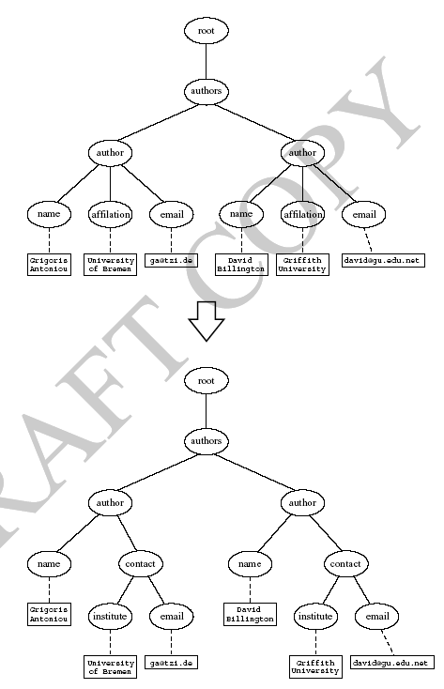
Transforming an XML Document to Another
(5) XSLT transformations

Slide 44
Transforming an XML Document to Another
<xsl:template match="/">
<?xml version="1.0" encoding="UTF-16"?>
<authors>
<xsl:apply-templates select="authors"/>
</authors>
</xsl:template>
<xsl:template match="authors">
<author>
<xsl:apply-templates select="author"/>
</author>
</xsl:template>
(5) XSLT transformations

Slide 45
Transforming an XML Document to Another
<xsl:template match="author">
<name><xsl:value-of select="name"/></name>
<contact>
<institution>
<xsl:value-of select="affiliation"/>
</institution>
<email><xsl:value-of select="email"/></email>
</contact>
</xsl:template>
(5) XSLT transformations

Slide 46
How to apply XSLT transforms
When modern browsers load an XML file, they apply a linked XSLT and display the results (hopefully HTML!)
You can also explicitly use
An external Web service
An XML editor
A module/library of your favorite programming language

Slide 47
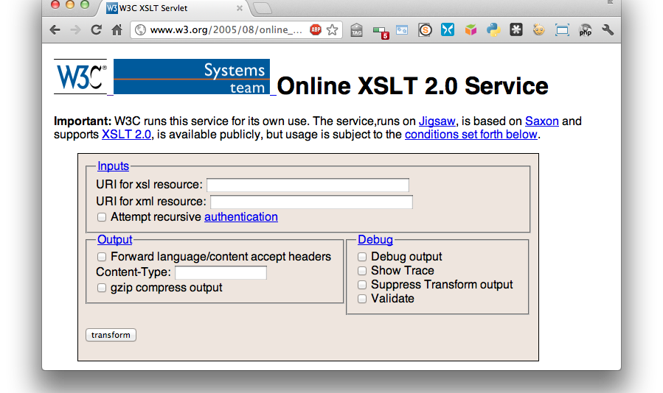
An XSLT Web Service
http://www.w3.org/2005/08/online_xslt/

Slide 48
CD Catalog example
<?xml-stylesheet type="text/xsl" href="cdcatalog.xsl"?>
<catalog>
<cd>
<title>Empire Burlesque</title>
<artist>Bob Dylan</artist>
<country>USA</country>
<company>Columbia</company>
<price>10.90</price>
<year>1985</year>
</cd>
<cd>
<title>Hide your heart</title>
<artist>Bonnie Tyler</artist>
<country>UK</country>
<company>CBS Records</company>
…
</cd> …
<xsl:template match="/">
<html> <body>
<h2>My CD Collection</h2>
<table border="1">
<tr bgcolor="#9acd32">
<th align="left">Title</th>
<th align="left">Artist</th>
</tr>
<xsl:for-each select="catalog/cd">
<tr>
<td><xsl:value-of select="title"/></td>
<td><xsl:value-of select="artist"/></td>
</tr>
</xsl:for-each>
</table>
</body> </html>
</xsl:template>
</xsl:stylesheet>
See these files online

Slide 49
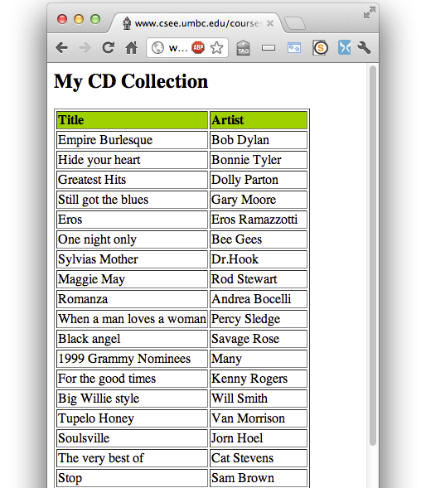
Viewing an XML file in a Browser
curl –L http://bit.ly/CdCat19
<?xml version="1.0" encoding="ISO-8859-1"?>
<?xml-stylesheet type="text/xsl" href="cdcatalog.xsl"?>
<catalog>
<cd>
<title>Empire Burlesque</title>
<artist>Bob Dylan</artist>
<country>USA</country>
<company>Columbia</company>
<price>10.90</price>
<year>1985</year>
</cd>
<cd>
<title>Hide your heart</title>
<artist>Bonnie Tyler</artist>
<country>UK</country>
<company>CBS Records</company>
<price>9.90</price>
<year>1988</year>
</cd>
...

Slide 50
XML Summary
XML is a metalanguage that allows users to define markup
XML separates content and structure from formatting
XML is (one of the) the de facto standard to represent and exchange structured information on the Web
XML is supported by query languages

Slide 51
Comments for Discussion
Nesting of tags has no standard meaning
Semantics of XML documents not accessible to machines and may or may not be for people
Collaboration & exchange supported if there is underlying shared understanding of vocabulary
XML well-suited for close collaboration where domain or community-based vocabularies are used; less so for global communication
Databases went from tree structures (60s) to relations (80s) and graphs (10s)

